Slide 1
Visual Recognition of Hair Disorders: Machine Learning for Classification
Harika Kakumanu
Gousia Parvin Patthan
Rithika MAHAREDDY

Slide 2
Introduction
Hair diseases can significantly impact an individual's physical appearance, self-esteem, and overall quality of life. These conditions encompass a wide range of disorders affecting the scalp and hair follicles, including alopecia, dermatitis, fungal infections, and more. Early diagnosis with Machine Learning can help :
Prevents Progression: Halts disease, protects scalp and hair.
Improves Outcomes: Timely treatment boosts efficacy and regrowth.
Boosts Well-being: Supports psychological health, enhances self-image.
Lowers Costs: Reduces use of healthcare resources, saves money.

Slide 3
Project Objectives
Our project focuses on utilizing machine learning techniques to predict hair diseases by analyzing scalp and hair follicle images. Our goal is to develop a diagnostic tool for accurately identifying various conditions, aiming to enhance early detection and treatment. In dermatology, accurate diagnosis is crucial for effectively managing skin and hair conditions

Slide 4
Data Collection
This Kaggle-sourced dataset encompasses 12,000 images, each illustrating a different type of hair disease. The dataset is methodically segmented into ten distinct classes: Alopecia Areata, Contact Dermatitis, Folliculitis, Head Lice, Lichen Planus, Male Pattern Baldness, Psoriasis, Seborrheic Dermatitis, Telogen Effluvium, and Tinea Capitis.
Each class consists of 1,200 images, which are further divided into training, testing, and validation sets. Specifically, for each disease category, there are 960 images allocated for training, 120 images reserved for testing, and another 120 images set aside for validation purposes. This structured arrangement of the dataset lays a solid foundation for conducting in-depth machine learning analysis and model training, aimed at identifying and classifying various hair diseases.

Slide 5

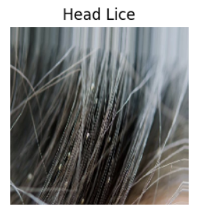
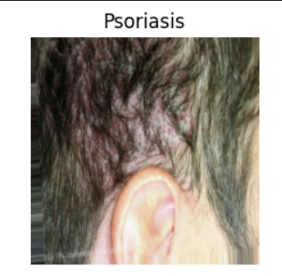
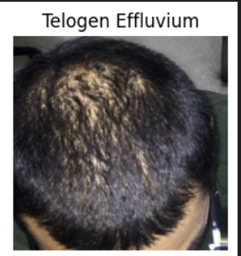
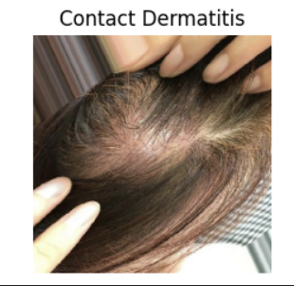
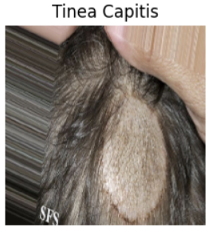
EDA

Slide 6
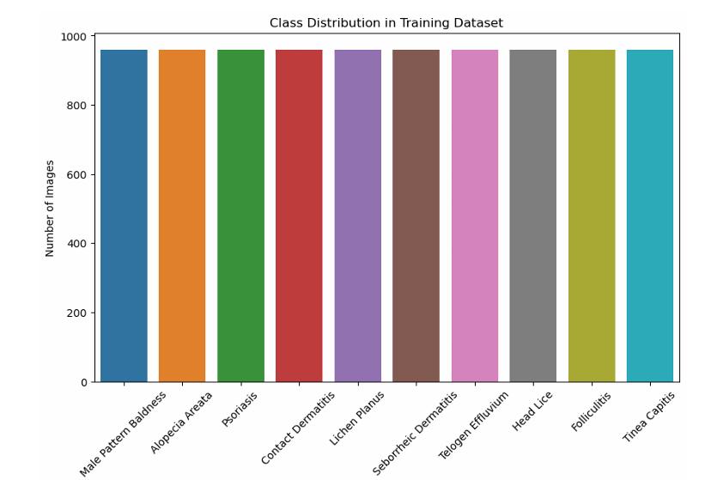
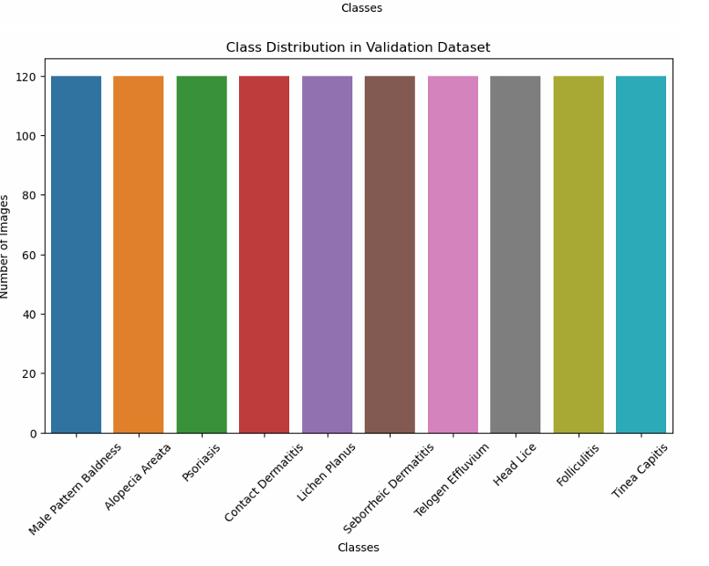
Class Distribution

Slide 7
Preprocessing
Rescaling: Pixel values of images are rescaled to the range [0, 1] using the rescale parameter in ImageDataGenerator.
Image Size Standardization: All input images are resized to a fixed size (224x224 pixels in this case) to ensure consistency in model input dimensions.

Slide 8
Architecture Overview:
Base Model - MobileNetV2: A pre-trained CNN is used
Input Layer: [224, 224, 3] (RGB images).
Convolutional Base:
1 Initial Conv2D Layer.
17 Blocks of Depthwise Separable Convolutions.
1 Depthwise Convolutional Layer.
1 Pointwise Convolutional Layer.
1 Final Conv2D Layer.
Activation Layers:
35 ReLU Activation Layers.

Slide 9
Pooling Layers:
1 Global Average Pooling Layer.
Custom Top Layers:
Flattening Layer.
Fully Connected Layer (Dense) with softmax activation.
Compile Model:
Loss Function: Categorical Crossentropy.
Optimizer: Adam.
Metrics: Accuracy.
Base MobileNetV2 layers frozen, except top layers.
Frozen layers retain pre-trained weights.
Top layers trainable for dataset adaptation.
Softmax activation ensures normalized probabilities.

Slide 10
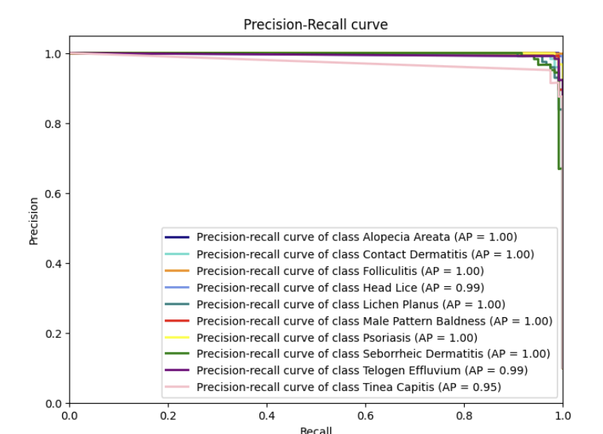
Results
Training accuracy: 0.9845 - val_loss: 0.2721 - val_accuracy: 0.9733
Test accuracy: 0.9708333611488342
The Precision-Recall curve shows that the classifier performs exceptionally well for most classes, achieving a perfect average precision score of 1.00. This indicates that the model maintains high precision while achieving high recall. However, certain conditions like Head Lice, Telogen Effluvium, and Tinea Capitis have slightly lower scores, close to 1.00, suggesting small areas for improvement. Overall, the classifier is highly effective in identifying the conditions evaluated.

Slide 11
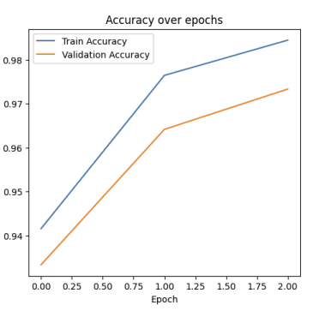
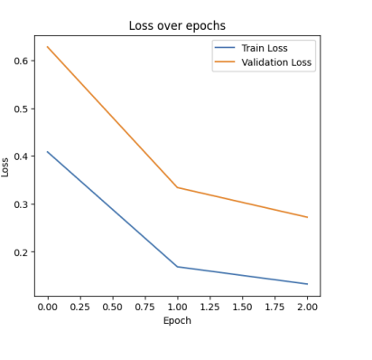
Model Training Performance: Accuracy and Loss Trends
The model exhibits high accuracy levels, with a strong performance on the training and validation datasets, as demonstrated by the close accuracy metrics.

Slide 12
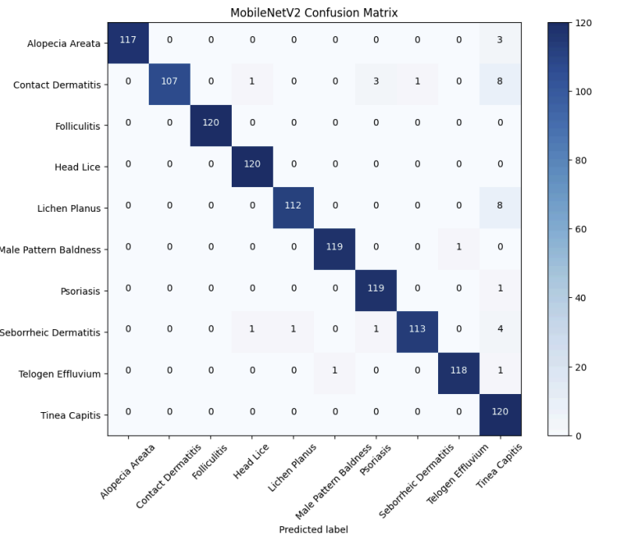
Confusion Matrix
The confusion matrix displays the performance of the MobileNetV2 model in classifying various hair conditions with high accuracy. Most conditions show a majority of correct predictions, with high numbers along the diagonal of the confusion matrix. There are minimal misclassifications, such as Contact Dermatitis being confused with Seborrheic Dermatitis. Despite a few errors, the model's ability to correctly identify most conditions is evident, showcasing its effectiveness.

Slide 13
InceptionV3 Model Architecture
Base Model - InceptionV3: Comprises 48 layers, designed for feature extraction at multiple scales.
Input Layer: [224, 224, 3] - suitable for standard RGB images.
Convolutional Base: Multiple 'Inception modules', each layer containing parallel convolutions with different kernel sizes (1x1, 3x3, 5x5).
Auxiliary Classifiers: Included to encourage learning throughout the depth of the network.
Pooling Layers: Utilizes average pooling to maintain spatial hierarchies while reducing dimensions.
Custom Top Layers: A Flatten layer, a 512-unit Dense layer with ReLU activation, followed by a 0.5 Dropout layer.
Output Layer: A Dense softmax layer tailored to the number of hair disease categories.
Model Compilation: Utilizes Adam optimizer, categorical crossentropy loss, and accuracy metric.
Layer Adaptation: Freezes InceptionV3 base layers for feature retention, with top layers tuned to our specific classification task.
Softmax Normalization: Ensures probabilistic interpretation of the output classes.

Slide 14
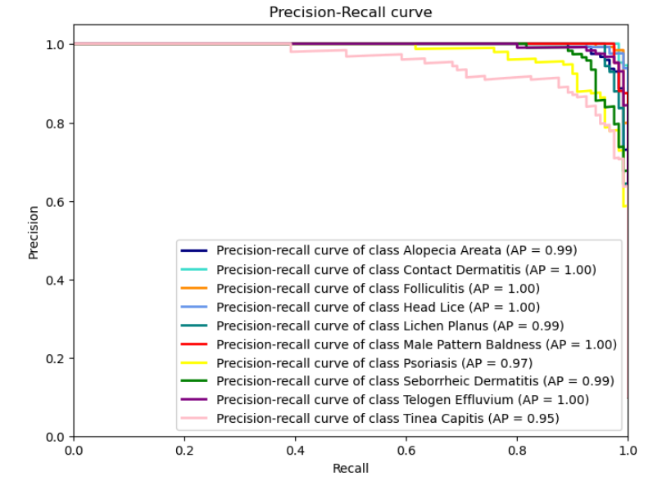
InceptionV3 Model Metrics
"Accuracy: 0.91"
"Macro Avg: 0.90"
"Weighted Avg: 0.90"
Note: "Accuracy reflects the overall rate of correct predictions. Macro and Weighted averages account for class imbalance."
"Classes like Contact Dermatitis and Head Lice show high precision across all levels of recall."
"Alopecia Areata and Tinea Capitis have slightly lower precision, indicating some room for improvement in model specificity for these conditions."

Slide 15
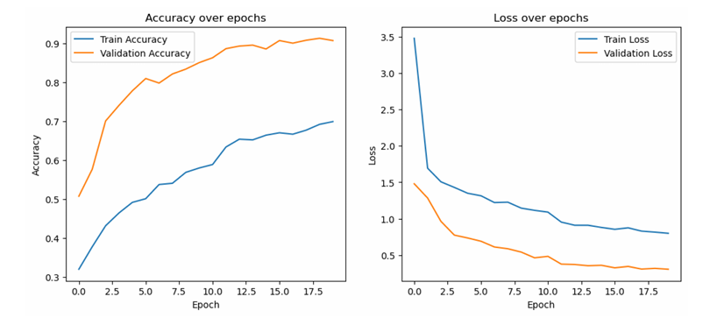
The increasing trend in accuracy and the decreasing trend in loss over epochs suggest that the model is learning and generalizing well.
The slight divergence between training and validation lines indicates potential overfitting, which could be addressed with regularization techniques or more data.

Slide 16
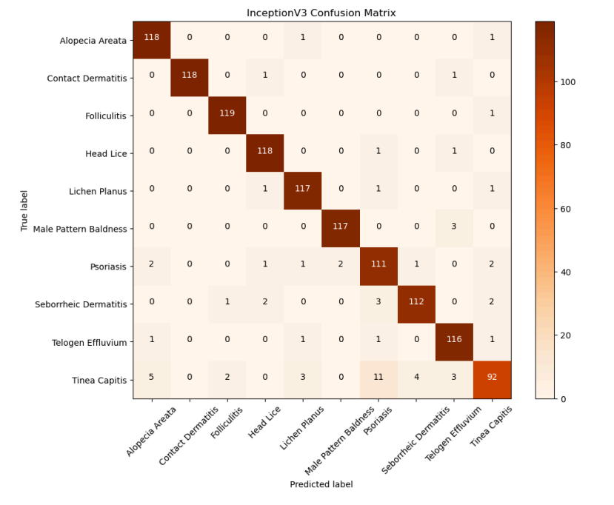
InceptionV3
The majority of the predictions are correct, as indicated by the high values along the diagonal. This suggests that the InceptionV3 model has a high accuracy for most classes.
For some diseases like Psoriasis and Tinea Capitis, there are notable off-diagonal values, which represent misclassifications. The presence of zeros in off-diagonal cells for some classes, like Contact Dermatitis and Folliculitis, indicates that the model did not make any misclassifications for these diseases.
The confusion matrix also shows how specific diseases might be confused with each other, indicating that the model might be struggling to distinguish between diseases with similar visual characteristics.

Slide 17
DenseNet169 Architecture
Base Model: DenseNet169, chosen for its dense connectivity pattern, which ensures maximum information flow between layers.
Input Shape: Tailored to 224x224x3, standard for processing RGB images.
Dense Blocks: Characterized by its dense connections where each layer receives inputs from all preceding layers, fostering feature reuse.
Activation: Utilizes ReLU activations across its dense layers to introduce non-linearities.
Pooling Layers: Employs global average pooling for dimensionality reduction before classification.
Custom Layers:
Global Average Pooling2D to minimize overfitting by reducing the total number of parameters.
A densely connected layer with ReLU activation followed by dropout for regularization.
Output prediction layer with softmax activation maps the features to disease classes.
Compilation:
Loss Function: Categorical Crossentropy, a standard for multi-class issues.
Optimizer: Adam, to adaptively update weights.
Metric: Accuracy is the primary evaluation metric.
Learning Rate Strategy: Features a learning rate scheduler for dynamic adjustment during training.

Slide 18
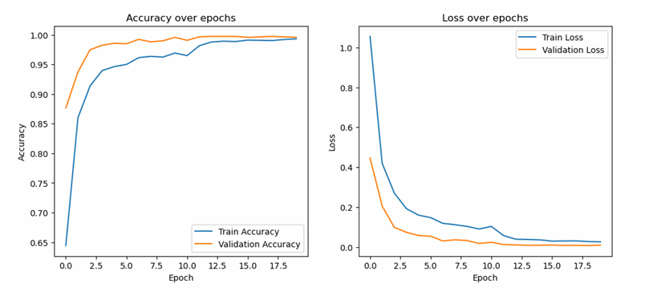
Performance Metrics:
Train Accuracy: 99.32%
Validation Accuracy: 99.58%
Test Accuracy: Achieved an impressive approximate of 99.66%.

Slide 19
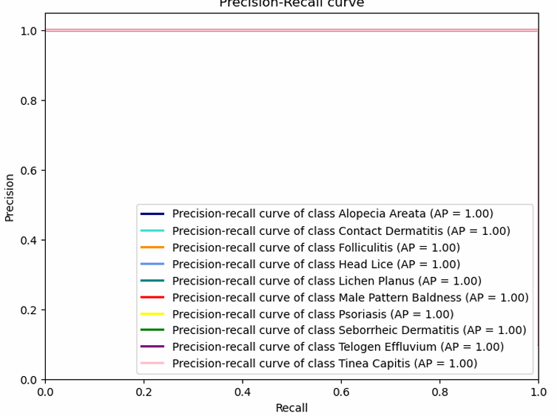
DenseNetV2 Model Metrics
"Accuracy: 99.66% "Macro Avg: 1.00 "Weighted Avg: 1.00 "Accuracy reflects the overall rate of correct predictions. Macro and Weighted averages are perfect in this case, indicating no class imbalance impact or an evenly distributed dataset." "Classes like Contact Dermatitis, Folliculitis, and Head Lice show perfect precision and recall scores." "Alopecia Areata has high precision and perfect recall, while Psoriasis shows high precision with a slightly lower recall, suggesting some room for improvement in model specificity for these conditions."

Slide 20
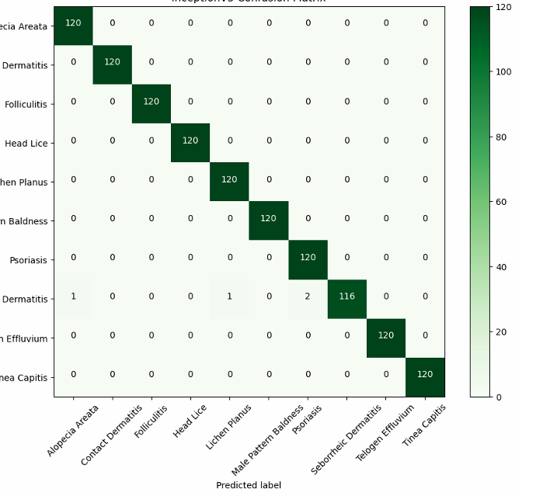
DenseNet169
The confusion matrix you've provided shows that the DenseNet169 model performs exceptionally well on the dataset, with the majority of the predictions correctly classified, as indicated by the high values along the diagonal of the matrix.

Slide 21
Conclusion
The DenseNet169 model achieved excellent performance with training accuracy at 99.32%, validation accuracy at 99.58%, and test accuracy 99.66%. The close accuracies across these datasets confirm the model's robustness in identifying and classifying data accurately. However, the discrepancy noted in the accuracy and loss plots, where training metrics continue to improve while validation metrics stabilize, suggests the onset of overfitting.
Future Recommendations:
1. Regularization Techniques: Implement regularization methods such as dropout or L2 regularization to prevent the model from learning overly complex patterns that do not generalize well to unseen data.
2. Hyperparameter Tuning: Experiment with different learning rates, batch sizes, and other hyperparameters that might influence the model's performance and ability to generalize.
3. Model Complexity: Consider experimenting with less complex models or adjusting the architecture to see if simpler models perform comparably but with better generalization.

Slide 22
References
Lin, R. L., Garibyan, L., Kimball, A. B., & Drake, L. A. (2016). Systemic causes of hair loss. Annals of Medicine, 48(6), 393-402. https://doi.org/10.1080/07853890.2016.1180426Wolff,
H., Fischer, T.W., & Blume-Peytavi, U. (2016). The Diagnosis and Treatment of Hair and Scalp Diseases. Dtsch Arztebl Int, 113(21), 377-386. https://doi.org/10.3238/arztebl.2016.0377. PMCID: PMC4908932, PMID: 27504707.https://www.ncbi.nlm.nih.gov/pmc/articles/PMC4908932/
Annalamai, S. Hair Diseases Dataset. Kaggle. https://www.kaggle.com/datasets/sundarannamalai/hair-diseases
Ahmed, A., Almohanna, H., Griggs, J., & Tosti, A. (2019). Genetic Hair Disorders: A Review. Dermatology and Therapy, 9, 421-448. https://doi.org/10.1007/s13555-019-0313-2Roy, M., & Protity, A. (2022).
Hair and Scalp Disease Detection using Machine Learning and Image Processing. https://www.researchgate.net/publication/366821677_Hair_and_Scalp_Disease_Detection_using_Machine_Learning_and_Image_Processing. doi:10.48550/arXiv.2301.00122

Slide 23


